Slide 1


Introduction to Digital Design in Verilog
Prepared by
Beig Rajibul Hasan
Lecturer, CSE, BRAC University
Contact: rajib.hasan@bracu.ac.bd

Slide 2
Introduction to Digital Design in Verilog

Slide 3

1
Introduction to CAD tools and design flow of a CAD system
2
Outline
Emergence of HDL and basic structures of Verilog
3
Verilog circuit representations and operators
4
Subcircuits in Verilog and additional datatypes
5
Texts and references used in this presentation

Slide 4

Evolution of CAD systems
Modern Integrated Circuits (IC) contain millions of transistors in a single chip. Placing so many transistors on the chip and finally verifying the functionality of the chip manually can be really frustrating for the chip architects.
As the complexity of the ICs grows every year proportionally with the shrinkage of the transistor sizes, computer-aided techniques become crucial for the design and verification of the digital ICs.
A general-purpose CAD system includes tools for different tasks such as: design entry, logic synthesis, simulation and physical design

Slide 5
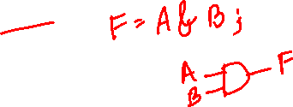
Introduction to CAD tools
Design Entry
- This is the first step of any design process which involves entering into the CAD system a description of the circuit being designed either by using schematic or writing source code.
Logic Synthesis
- Synthesis is the process of generating a logic circuit from an initial specification provided in the Design Entry stage. The output is a set of logic expressions that describe the logic functions needed to realize the circuit.

Slide 6

Introduction to CAD tools
Simulation
- A circuit represented in the form of logic expressions can be simulated to verify that it will function as expected. The tool that performs this task is called a functional simulator.
Physical Design
- The physical design tools map a circuit specified in the form of logic expressions into a realization that makes use of the resources available on the target chip.

Slide 7
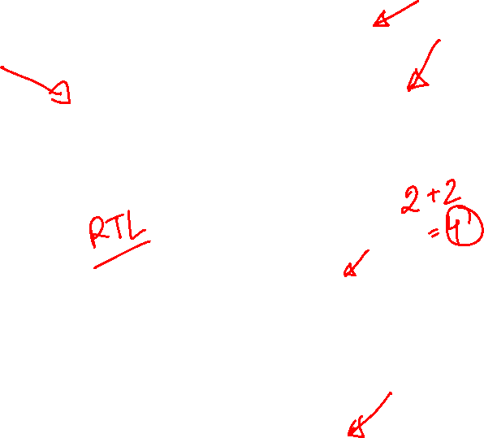
Design conception
Design Entry
Schematic Capture
Source Code
Design flowchart of a typical CAD system
Logic Synthesis
Simulation
No
Design Correct?
Yes
Physical Design
Chip configuration
CSE460 : VLSI Design

Slide 8



CAD tools providers

Slide 9


Emergence of HDLs
Hardware Description Languages (HDLs) allow the designers to model the concurrency of the processes found in the hardware elements.
Designs can be described at a very abstract level by using HDLs.
The RTL description of the design derived from the HDL source code can be converted into any fabrication technology using the logic synthesizer tools.
By describing the design in HDLs, functional verification can be performed very easily.

Slide 10
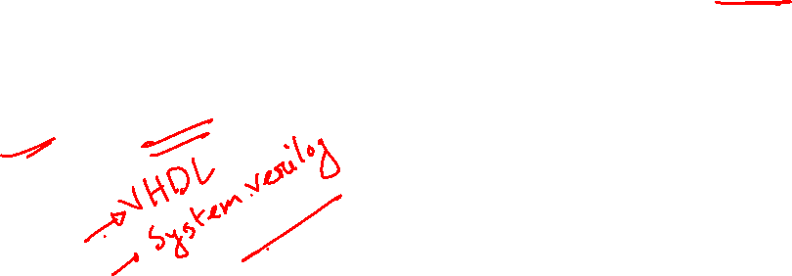
Verilog HDL
Verilog HDL is a general-purpose hardware description language which can describe the digital circuits with C-like syntax.
Most popular logic synthesis tools support Verilog HDL.
Digital circuits can be described at the RTL of abstraction which ensures design portability.

Slide 11
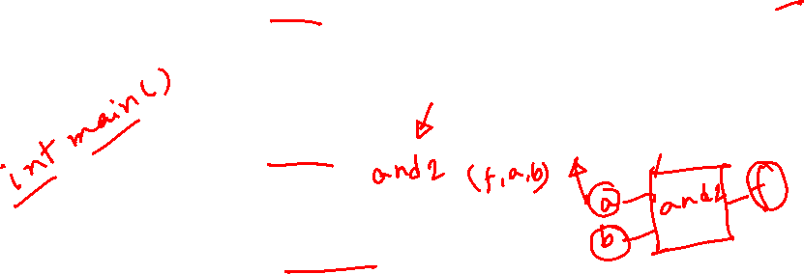
Basic building block of Verilog
A module is the basic building block of Verilog. A module consists of port declaration and Verilog codes to perform the desired functionality.
Ports are means for the Verilog module to communicate with other modules or interfaces. Ports can be of 3 types, such as: input, output, inout.
A typical Verilog module declaration:
module <name> (<ports_list>);
…
// Verilog Codes //
…
endmodule

Slide 12

Verilog module and ports
Verilog module declaration
module encoder_4to2 (x, y, a, b, c, d);
input a, b, c, d;
output x, y;
…
// Verilog Code //
…
endmodule
Logic Synthesis
a
encoder_4to2
b
x
c
y
d

Slide 13
Basic Syntax and Lexical Conventions
Documentation in Verilog code
- Documentation can be included in Verilog code by writing comments. A short comment begins with a double slash ( // ). A long comment spans multiple lines and is contained inside /* and */.
module fulladd(s, cout, a, b, cin);
// A full adder verilog module
/*
This module takes three inputs a, b, cin and adds them.
The sum of the inputs are stored in s, the carryout is stored in cout.
*/
input a, b, c;
output s, cout;
// Verilog Code //
endmodule

Slide 14

Basic Syntax and Lexical Conventions
White space
- White space characters such as SPACE and TAB are ignored by the Verilog compiler. Although multiple statements can be written in a single line, placing each statement in a single line and using indentation within blocks of code are good ways to increase readability of the code.
Number specification
- There are two types of number specifications found in verilog, sized and unsized.
- sized numbers are represented as: <size> ‘<base format> <value>. Supported formats are:
Base format | Illustration
d | decimal
b | binary
h | hexadecimal
o | octal

Slide 15
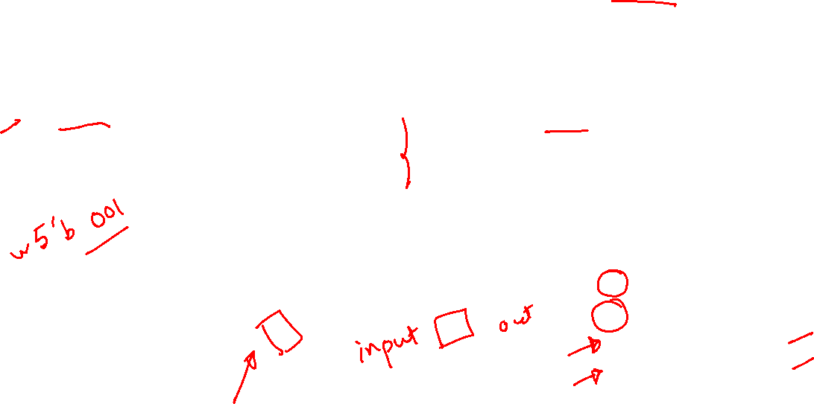
Basic Syntax and Lexical Conventions
- If a number is specified without a base format, it is treated as a decimal number by the Verilog compiler.
- unsized numbers are specified without a size specification. unsized numbers are assigned a specific number of bits which is simulator and machine-specific (at least 32 bits).
Value Set
- Each individual signal/variable in Verilog can be assigned one
of 4 values:
sized number representation | unsized number representation
5’b10001 // This is a 5-bit binary number 4’hff01 // This is a 4-bit hexadecimal number 3’o123 // This is a 3-bit octal number 2’d10 // This is a 2-bit decimal number | 1254 // This is a 32-bit decimal number by default ‘h21ff // This is a 32-bit hexadecimal number ‘o345 // This is a 32-bit octal number ‘b1100 // This is a 32-bit binary number
Value level | Condition in Hardware
0 | logic 0 / False
1 | logic 1 / True
x | undefined
z | high impedance

Slide 16

Basic Syntax and Lexical Conventions
Nets
- Nets represent connections between hardware elements. Nets are continuously driven by the outputs of the devices they are connected to.
- Nets are declared with the keyword wire. A net is assigned the value z by default.
Registers
- In verilog register means a variable that can hold a value. Unlike net, a register doesn’t need a driver.
- Registers are declared with the keyword reg. The default value of a reg data type is x.
wire a, b; // wire declaration
reg clock; // register declaration

Slide 17

Basic Syntax and Lexical Conventions
Vectors
- wire or reg type data types can also be declared as vectors (multiple bit widths). If bit width is not specified, the default is scalar (1-bit).
- The multibit nets/registers or vectors in general can be declared in Verilog using the syntax:
<data type> <MSB bit index : LSB bit index> <name>
module example(a, b);
input b;
output a;
wire [7:0] in1, in2; // 8-bit wire type variables
reg [0:31] base_clk; // 32-bit reg type variable
assign a = in1[7] * in2[2];
endmodule

Slide 18
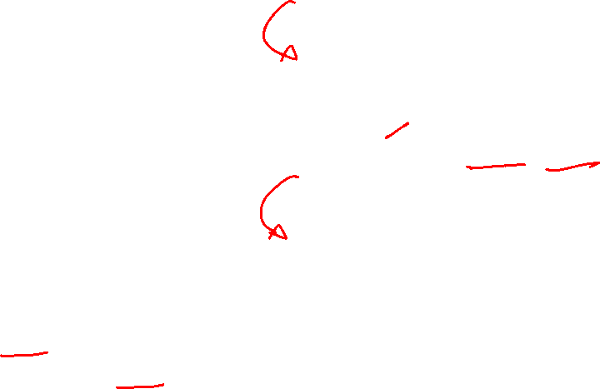
Basic Syntax and Lexical Conventions
reg [7:0] mem [15:0];
// mem is defined as an array containing 16 elements each being 8 bits wide
Memories
- A memory is a two-dimensional array of bits. Verilog allows such a structure to be declared as a variable that is an array of vectors.
Parameters
- A parameter associates an identifier name with constants.
mem[15] | mem[14] | …… | mem[1] | mem[0]
reg [7:0] mem [7:0] [15:0];
// mem is defined as a two-dimensional array.
mem[7][15] | mem[7][14] | … | mem[7][1] | mem[7][0]
mem[6][15] | mem[6][14] | … | mem[6][1] | mem[6][0]
… | … | … | … | …
mem[1][15] | mem[1][14] | … | mem[1][1] | mem[1][0]
mem[0][15] | mem[0][14] | … | mem[0][1] | mem[0][0]
parameter n = 5;

Slide 19

Basic Syntax and Lexical Conventions
Identifier Names
Identifiers are the names of variables and other elements in Verilog code.
Valid identifier can include any letter and digit as well as “_” and “$” characters. There are two restrictions too , an identifier must not begin with a digit and it should not be a Verilog keyword. Furthermore, Verilog is case sensitive.
Identifier name | Validity
x1 | Valid
x_y | Valid
1x | Invalid
+y | Invalid
x*y | Invalid
258 | Invalid
ex_$1 | Valid

Slide 20
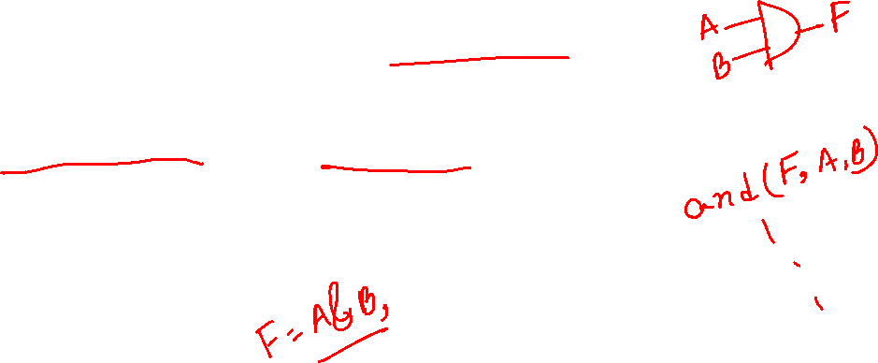
Verilog Representations of Digital Circuits
Verilog allows designers to describe a digital circuit in several ways. Among them two fundamental representations are: structural representation and behavioral representation.
Structural representation
- Structural representation is to use Verilog's gate-level primitives to describe the digital circuit. Various gate-level primitives are included in Verilog such as: and gate, or gate, not gate, nand gate, nor gate etc.
Behavioral representation
- Using gate-level primitives can be tedious while designing larger circuits. Instead, the designers use more abstract expressions and programming constructs to describe the circuit. This is called the behavioral representation of the digital circuit.

Slide 21








Structural representation
$$x_{1}$$
$$x_{2}$$
$$g$$
module example_ckt(f, x1, x2, x3);
input x1, x2, x3;
output f;
wire g, y, h;
and(g, x1, x2);
not(y, x2);
and(h, y, x3);
or(f, g, h);
endmodule
module example_ckt(f, x1, x2, x3);
input x1, x2, x3;
output f;
wire g, y, h;
and(g, x1, x2);
not(y, x2);
and(h, y, x3);
or(f, g, h);
endmodule
module example_ckt(f, x1, x2, x3);
input x1, x2, x3;
output f;
wire g, y, h;
and(g, x1, x2);
not(y, x2);
and(h, y, x3);
or(f, g, h);
endmodule
module example_ckt(f, x1, x2, x3);
input x1, x2, x3;
output f;
wire g, y, h;
and(g, x1, x2);
not(y, x2);
and(h, y, x3);
or(f, g, h);
endmodule
$$f$$
$$y$$
$$h$$
$$x_{3}$$
x1 | x2 | x3 | f
0 | 0 | 0 | 0
0 | 0 | 1 | 0
0 | 1 | 0 | 0
0 | 1 | 1 | 1
1 | 0 | 0 | 1
1 | 0 | 1 | 1
1 | 1 | 0 | 0
1 | 1 | 1 | 1
$$f=x_{1} . x_{2}+ \overline{x_{2}} . x_{3}$$

Slide 22




Behavioral representation
$$x_{1}$$
$$x_{2}$$
$$\#n_{2}$$
module example_ckt(f, x1, x2, x3);
input x1, x2, x3;
output f;
assign f = (x1 & x2) | (~x2 & x3);
endmodule
$$f$$
$${\#n}_{1}$$
$${\#n}_{3}$$
$$x_{3}$$
x1 | x2 | x3 | f
0 | 0 | 0 | 0
0 | 0 | 1 | 0
0 | 1 | 0 | 0
0 | 1 | 1 | 1
1 | 0 | 0 | 1
1 | 0 | 1 | 1
1 | 1 | 0 | 0
1 | 1 | 1 | 1
$$f=x_{1} . x_{2}+ \overline{x_{2}} . x_{3}$$

Slide 23
Verilog Operators
Verilog supports a large number of operators for carrying out different types of operations. Verilog operators can be broadly classified into the following categories:
Bitwise operators
Logical operators
Arithmetic operators
Relational operators
Shift operators
Concatenate operator
Replication operator
Condition operator

Slide 24
Verilog Operators
Bitwise operators
Operator | Operation
~A | This will produce 1’s complement of A
-A | This will produce 2’s complement of A
A & B | Bitwise AND
A | B | Bitwise OR
A^B | Bitwise XOR
A^~B / A~^B | Bitwise XNOR

Slide 25
Verilog Operators
Logical operators
These operators work on single or multi bit operands but generate 1 bit result i.e., True or False.
Operator | Operation
!A | NOT A(!A) produces “1(True)” only if all bits of A are 0 else !A gives “0(False)”
A&&B | The result of A&&B is “1(True) if both A and B are nonzero
A|| B | A||B gives “1(True)” unless both A and B are zero.

Slide 26
Verilog Operators
Arithmetic operators
Operator | Operation
A+B | Addition of two single or multibit numbers
A-B | Subtraction of two single or multibit numbers
A*B | Multiplication of two single or multibit numbers
A/B | Division of two single or multibit numbers
A%B | This returns the remainder of the integer division A/B

Slide 27
Verilog Operators
Relational operators
Operator | Operation
A == B | 1 (True) if A is equal to B, 0 (False) otherwise
A != B | 1 (True) if A is not equal to B, 0 (False) otherwise
A > B | 1 (True) if A is greater than B, 0 (False) otherwise
A < B | 1 (True) if A is less than B, 0 (False) otherwise

Slide 28

Verilog Operators
Operator type | Symbol | Operation performed
Shift | >> | Shift right logical
 | << | Shift left logical
Concatenate | {} | Join bits
Replicate | {n{m}} | Duplicate m, n times
Condition | D = A ? B : C | D is equal to B if A is True, otherwise D is equal to C
wire [7:0] d; wire [31:0] e; wire [31:0] f; assign f = {d, e[23:0]}; // Concatenation + Slicing assign f = { 32{d[5]} }; // Replication + Indexing

Slide 29
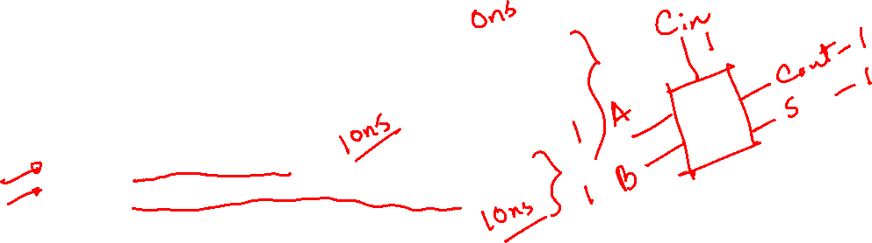
Concurrent Statements
In any HDL, concurrent statement means the code may include a number of statements and each represent a part of the circuit.
What concurrent means:
Concurrent is used because the statements are considered in parallel and the ordering of statements in the code doesn’t matter. Most frequently used concurrent statements in Verilog are the continuous assignments.
module full_add(S, Cout, A, B, Cin); // This module implements a 1 bit full adder input A, B, Cin; output S, Cout; assign S = A ^ B ^ Cin; assign Cout = (A & B) | (Cin & (A ^ B)); endmodule

Slide 30
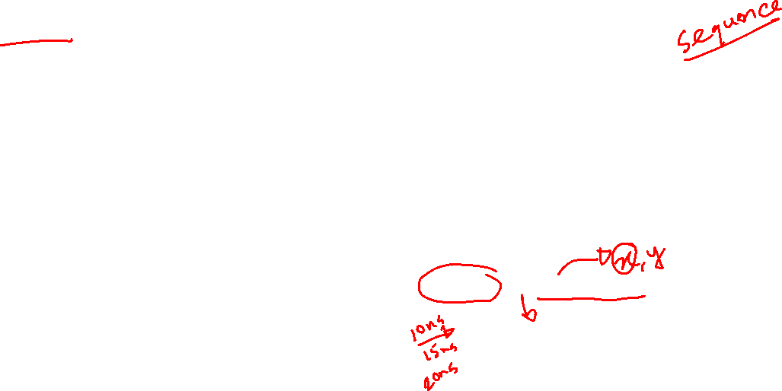
Procedural Statements
In addition to the concurrent statements Verilog also provides procedural statements. As discussed, concurrent statements are executed in parallel, procedural statements are evaluated in the order they appear in the code. Verilog syntax requires that procedural statements to be contained inside an always block
Always Block:
Concurrent is used because the statements are considered in parallel and the ordering of statements in the code doesn’t matter. Most frequently used concurrent statements in Verilog are the continuous assignments.
always @ (sensitivity_list)
[begin]
[procedural assignment statements]
[if-else statements]
[case statements]
[while, repeat and for loops]
[end]
An always block is a construct that contains one or more procedural statements.
When multiple statements are included in an always block . The begin and end keywords must be used.
Output variables within the always block must be variable of reg type.

Slide 31

Procedural Statements
The If-else statement:
always @(*)
if(expression1)
begin
statement;
end
else if(expression2)
begin
statement;
end
else
begin
statement
end
end
If expression1 is True then the first statement is evaluated.
If not , then the compiler will consider other expressions.
The else if and else clauses are optional.
When multiple statements are involved, they have to be included inside a begin-end block

Slide 32
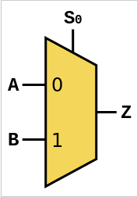
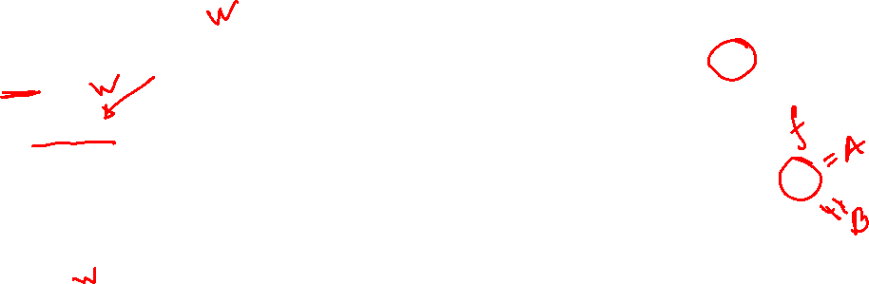
Procedural Statements
The If-else statement:
module mux2to1(A, B, S, f);
input A, B, S;
output reg f;
always @(A, B, S)
begin
if(S == 0)
f = A;
else
f = B;
end
endmodule

Slide 33
Subcircuits in Verilog
A Verilog module can be included as a subcircuit in another module.
Both module must be defined in the same file or else Verilog compiler must be told where each module is located.
The general form of module instantiation expression is
<module_name> <instance_name> ( <port_name[expressions]>)
In the above definition
module_name is the name of the module of the child circuit that is to be included in the parent circuit.
instance_name can be any legal Verilog identifiers.
port_name basically is the list of ports that specify the connections that will be passed to the subcircuit.

Slide 34





































4-bit Ripple Carry Adder
stage0
stage1
stage2
stage3
$$A_{0}$$
$$B_{0}$$
$$A_{1}$$
$$B_{1}$$
$$A_{2}$$
$$B_{2}$$
$$A_{3}$$
$$B_{3}$$
$$A$$
$$B$$
$$A$$
$$B$$
$$A$$
$$B$$
$$C_{out,2}$$
$$A$$
$$B$$
$$C_{in}$$
$$C_{out,0}$$
$$C_{out,1}$$
$$C_{out}$$
$$C_{in}$$
$$C_{out}$$
$$C_{in}$$
$$C_{out}$$
$$C_{in}$$
$$C_{out}$$
$$C_{in}$$
$$C_{out}$$
$$S$$
$$S$$
$$S$$
$$S$$
$$S_{0}$$
$$S_{1}$$
$$S_{2}$$
$$S_{3}$$

Slide 35
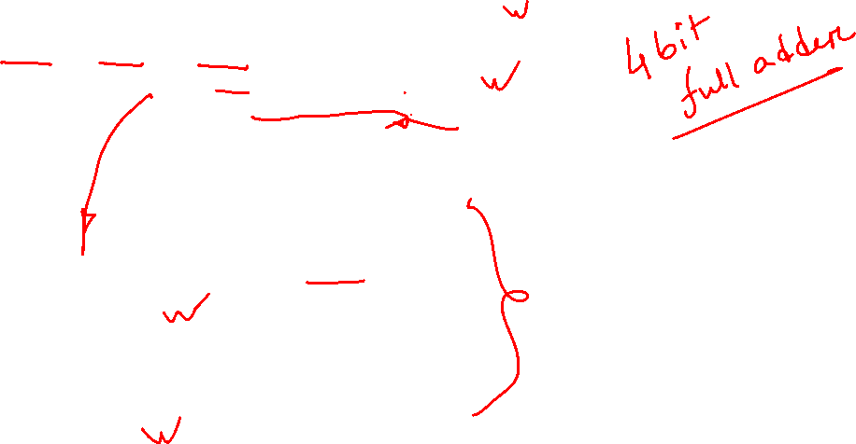
4-bit Ripple Carry Adder
module fulladd4(S0, S1, S2, S3, Cout, A0, A1, A2, A3, B0, B1, B2, B3, Cin); input A0, A1, A2, A3, B0, B1, B2, B3, Cin; output S0, S1, S2, S3, Cout; wire Cout0, Cout1, Cout2; fulladd stage0 (S0, Cout0, A0, B0, Cin); fulladd stage1 (S1, Cout1, A1, B1, Cout0); fulladd stage2 (S2, Cout2, A2, B2, Cout1); fulladd stage3 (S3, Cout, A3, B3, Cout2); endmodule module fulladd(S, Cout, A, B, Cin); // This module implements a 1-bit full adder input A, B, Cin; output S, Cout; assign S = A ^ B ^ Cin; assign Cout = (A & B) | (Cin & (A ^ B)); endmodule

Slide 36
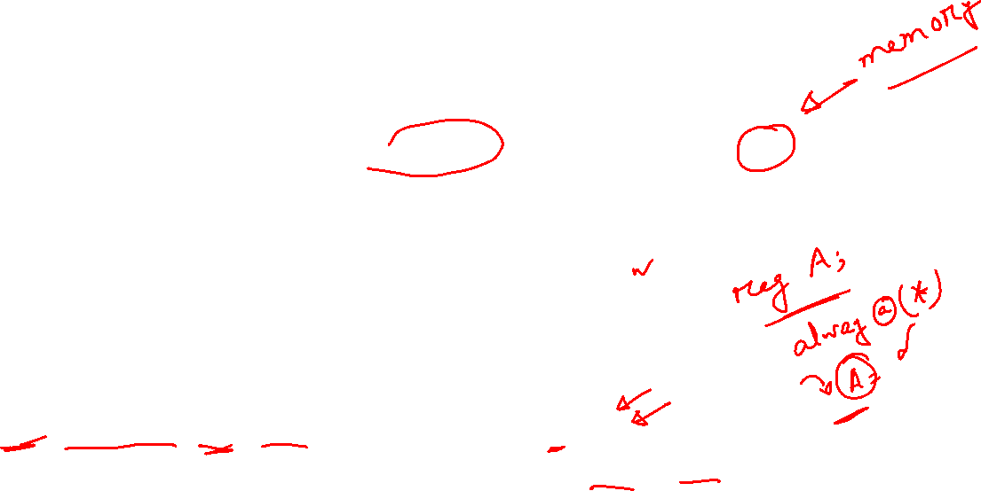
wire vs reg
When to use which?
If a signal needs to be assigned inside an always block, it must be declared as a reg.
If a signal is assigned using a continuous assignment statement, it must be declared as a wire.
By default, module input and output ports are wires; if any output ports are assigned in an always block, they must be explicitly declared as reg:
output reg <signal name>
How to know if a net represents a register or a wire?
A wire net always represents a combinational link
A reg net represents a wire if it is assigned in an always @ (*) block
A reg net represents a register if it is assigned in an always @ (posedge/negedge clock) block
[Reference: https://inst.eecs.berkeley.edu/~eecs151/fa20/files/verilog/Verilog_Primer_Slides.pdf]

Slide 37

Additional Verilog Datatypes
Verilog supports 3 additional register datatypes such as: integer, real and time.
Integer datatypes are general-purpose register datatypes which are broadly used as loop variables (iterators). The default size of an integer is 32 bits. Integer type variables are declared with the Verilog keyword integer. Unlike reg which can only store unsigned values, integer can store signed quantities as well.
Real number constants and real register datatypes are declared with the keyword real. They can be specified in decimal notation or in scientific notation. A real variable is declared with the keyword real. When a real value is assigned to an integer, the real number is rounded off to the nearest integer.
Verilog simulation is done with respect to simulation time. A special time register data type is used in Verilog to store simulation time. A time variable is declared with the keyword time. The default size of a time variable is 64 bits. The system function $time is invoked to get the current simulation time.

Slide 38

Additional Verilog Datatypes
// Syntax for integer, real and time register datatypes real delta, alpha; // Defines two real variables called 'delta' & 'alpha’ initial /* initial block represents procedural statements in Verilog. The lines written inside this block are executed only once, right at the beginning of the simulation type. */ begin delta = 4e10; alpha = 3.14; end integer i; // Defines an integer 'i’ initial i = alpha; // i gets the value 3 (rounded value of 3.14) time sim_time; // Defines a time variable named 'sim_time’ initial sim_time = $time; // Saves the current simulation time

Slide 39
Text & References
# | Title | Author(s) | Edition
1. | CMOS VLSI Design | N.H.E. Weste, D. Harris & A. Banerjee | 4th ed.
2. | Fundamentals of Digital Logic with Verilog Design | Stephen Brown & Zvonko Vranesic | 2nd/3rd ed.
3. | Verilog HDL (A guide to Digital Design and Synthesis) | Samir Palnitkar | 1st ed.

